Slide 1
CSCIU 210 Computer Organization AKM Jahangir A Majumder, PhD
Fall 2018 - Lecture 18
October 8, 2018
Note: Some slides are adapted from those used by previous instructors and some slides include figures from the textbook.

Slide 2
Review and Learning Outcomes
We will continue to cover Multiplexer, Demultiplexer
Decoder and Multiplexer
Encoder and Priority Encoder
Exam 1 grades and Keys are posted on Blackboard
Mean: 84.29
Median: 89.00
Standard Deviation: 12.18
Quiz 3 grades and Keys are posted on Blackboard as well
Keys for HW 3 is posted on Blackboard
We will have Quiz 4 on Wednesday, October 17
No Class on Friday, October 12

Slide 3
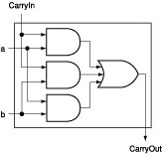
In-Class Exercise: Exam Problem
Show the circuit diagram below can also implement carry out function of a full-adder.
c_{out}
=
a
b
+
(
a
⊕
b
)
c_{in}
Input |  |  | Output
a | b | Carryin | Carryout
0 | 0 | 0 | 0
0 | 0 | 1 | 0
0 | 1 | 0 | 0
0 | 1 | 1 | 1
1 | 0 | 0 | 0
1 | 0 | 1 | 1
1 | 1 | 0 | 1
1 | 1 | 1 | 1

Slide 4
Review: Function of an Multiplexer
4-1 multiplexer
S₁ | S₀ | Y
0 | 0 | I₀
0 | 1 | I₁
1 | 0 | I₂
1 | 1 | I₃
I0
Mux
I1
I2
Y
I3
2
s

Slide 5
Building of a 2-to-1-Line Multiplexer
The single selection variable S has two values:
S = 0 selects input I₀
S = 1 selects input I₁
The equation:
Y = S’I₀ + SI₁
The circuit:

Slide 6
Building of 4-to-1-line Multiplexer
2-to-2²-line decoder
2² × 2 AND-OR

Slide 7
Multiplexor (Mux)
Mux: A popular combinational building block
Routes one of its N data inputs to its one output, based on binary value of select inputs
4 input mux → needs 2 select inputs to indicate which input to route through
8 input mux → 3 select inputs
N inputs → log₂(N) selects
Like a rail yard switch

Slide 8
Mux Internal Design
i0
i0 (1*i0=i0)
2
×
1
2
×
1
2
×
1
1
d
i0 (0+i0=i0)
i0
i0
i0
i1
i1
d
i1
d
i1
d
0
0
s0
s0
s0
a
0
1
2x1 mux
0
s0
i0
4
⋅
1
i0
i1
i1
d
i2
d
i2
i3
s1
s0
i3
4x1 mux
s1
s0

Slide 9
Mux Example
City mayor can set four switches up or down, representing his/her vote on each of four proposals, numbered 0, 1, 2, 3
City manager can display any such vote on large green/red LED (light) by setting two switches to represent binary 0, 1, 2, or 3
Use 4x1 mux
Mayor’s switches
a
1
4x1
on/off
i0
2
i1
i2
d
Proposal
3
i3
Green/
Red
LED
s1
s0
4
manager's
switches

Slide 10
Muxes Commonly Together – N-bit Mux
a3
i0
2x
1
Simplifying
notation:
b3
i1
d
s0
4-bit
4
a2
i0
2x
1
4
2x1
C
i1
d
A
I
0
4
b2
s0
4
D
C
is short
B
I
1
f
or
a1
i0
2x
1
s0
b1
i1
d
c3
s0
2x
1
s0
c2
a0
i0
d
b0
i1
c1
s0
s0
c0
Ex: Two 4-bit inputs, A (a3 a2 a1 a0), and B (b3 b2 b1 b0)
4-bit 2x1 mux (just four 2x1 muxes sharing a select line) can select between A or B

Slide 11
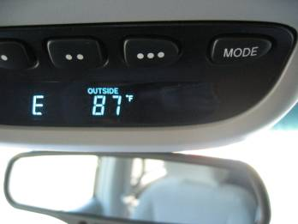
N-bit Mux Example
From the car's central computer
8-bit
a
T
8
4x1
I0
A
8
To the above-mirror display
I1
8
D
I
8
D
I2
M
8
I3
s1
s0
x
y
W
e'll design
this later
b
utton
Four possible display items
Temperature (T), Average miles-per-gallon (A), Instantaneous mpg (I), and Miles remaining (M) – each is 8-bits wide
Choose which to display on D using two inputs x and y
Pushing button sequences to the next item
Use 8-bit 4x1 mux

Slide 12
Demultiplexer (demux)
A demux performs the reverse operation from the mux
The demux routes one input to 1-of-n outputs based on the select-line input combination
System description for 4 output demux (2 select-lines)
y₀ = i·s₁’·s₀’
y₁ = i·s₁’·s₀
y₂ = i·s₁·s₀’
y₃ = i·s₁·s₀
Recall from the decoder a description could be given as follows:
y₀ = G·s₁’·s₀’
y₁ = G·s₁’·s₀
y₂ = G·s₁·s₀’
y₃ = G·s₁·s₀

Slide 13
Demux (concluded)
You can see, from the previous expressions, that the demux could be implemented with a decoder that has an enable
Just connect I to G of the decoder and you have a demux.
Warning: Most CAD tools rely on the user knowing this fact … … the libraries do not contain any demuxes, just decoders.
0
y₀
y₀
0
y₀
y₀
2x4 decoder
2x4 decoder
i₀
y₁
y₁
i₀
y₁
y₁
0
i₁
y₂
y₂
1
i₁
y₂
y₂
s₀
y₀
y₀
2x4 decoder
s₁
i₀
y₁
y₁
i
G
y₃
y₃
i
G
y₃
y₃
i₁
y₂
y₂
i
G
y₃
y₃
1
y₀
y₀
1
y₀
y₀
2x4 decoder
2x4 decoder
i₀
y₁
y₁
i₀
y₁
y₁
0
i₁
y₂
y₂
1
i₁
y₂
y₂
i
G
y₃
y₃
i
G
y₃
y₃

Slide 14
Additional Considerations Non-Ideal Gate Behavior -- Delay
2.10
x
y
F
1
1
1
x
x
x
0
0
0
1
1
1
y
y
y
0
0
0
(1.8
V)
1
1
1
F
F
F
(0
V)
0
0
0
time
time
time
(
a
)
(
b
)
a
(
c
)
ideal
a
more realistic
with delay but otherwise ideal
a
Real gates have some delay
Outputs don’t change immediately after inputs change

Slide 15
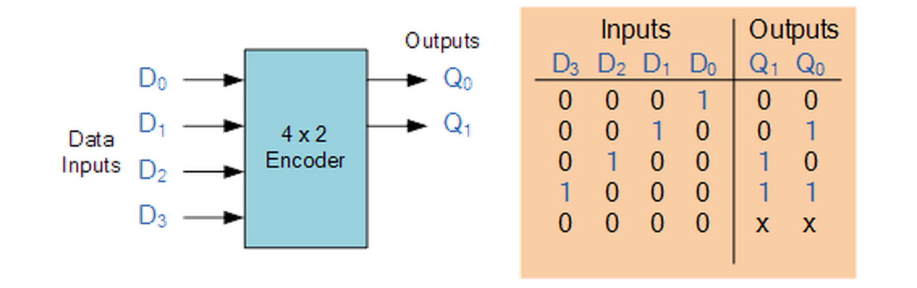
Encoder
Takes in multiple inputs and converts them into a single encoded output
4to2 Bit Binary encoder
What if there’s more than one 1 at the input?!

Slide 16
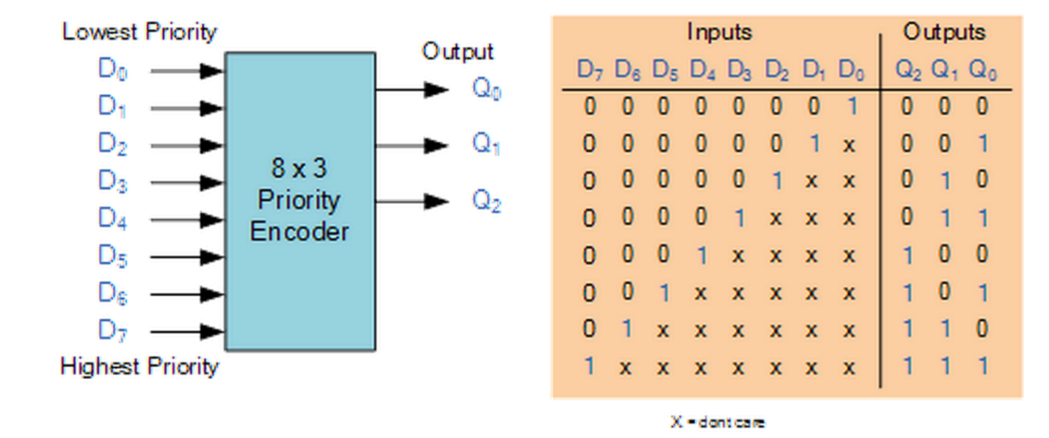
Priority Encoder
Solves the problems mentioned previously
Allocates a priority level to each input
Output corresponds to the currently active input that has the highest priority
When an input with a higher priority is present, ALL other lower priority inputs will be ignored

Slide 17
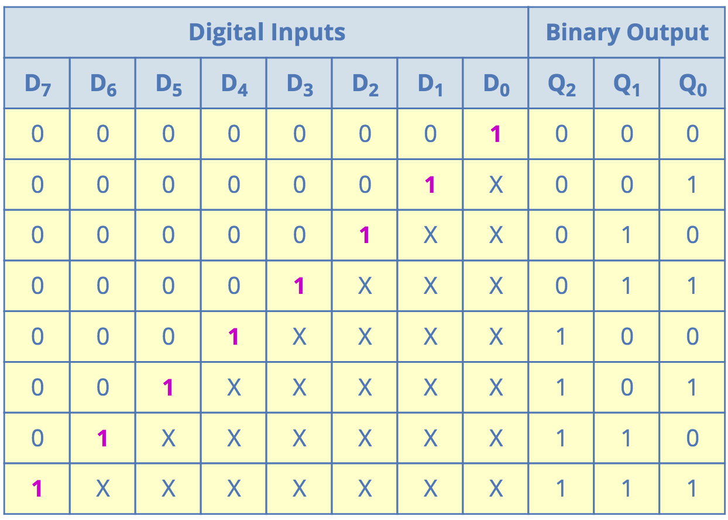
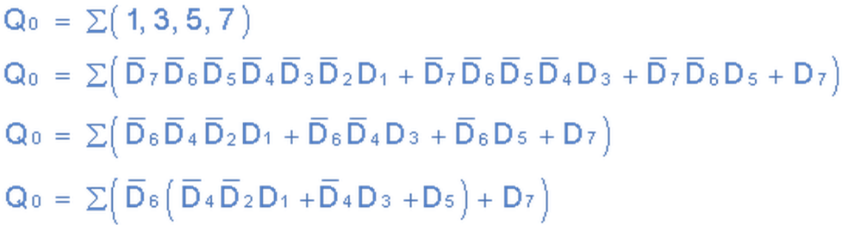
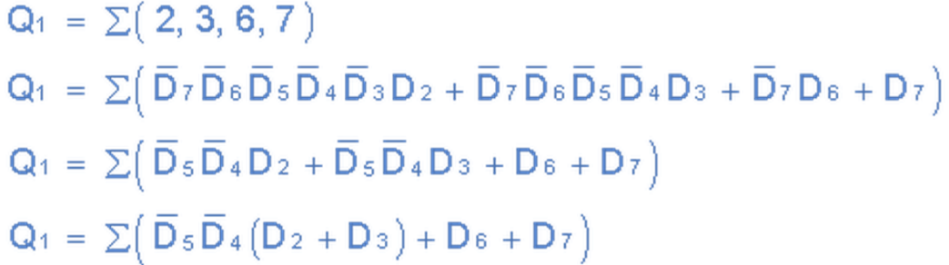
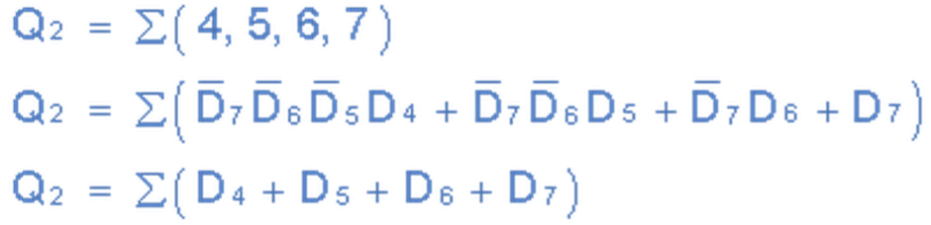
Priority Encoder

Slide 18
Summary of Materials We Covered up to Now
So far, we covered the following important concepts:
Fundamental Logic Gates and Some Important Logic Components
Decoder and Multiplexer.
Boolean Algebra
Number Representation with Different Bases
Decimal, Binary, Hexadecimal, Octal.
Binary Addition and Subtraction with the 2’s complement
Overflow Detection
We are going to use the concepts we covered up to now to build a simple ALU (Arithmetic Logical Unit)

Slide 19
ALU Functions
We want to build a 32-bit ALU which can perform the following operations:
and, or, nor, add, subtract, and slt (set on less than)
operation
a
32
ALU
result
32
b
32

Slide 20
An ALU (arithmetic logic unit)
Let's build an ALU to support the ‘and’ and ‘or’ functions at the first.
we'll just build a 1 bit ALU, and use 32 of them
Possible Implementation (sum-of-products):
operation
op
a
b
res
a
b
ALU
result

